Slide 1
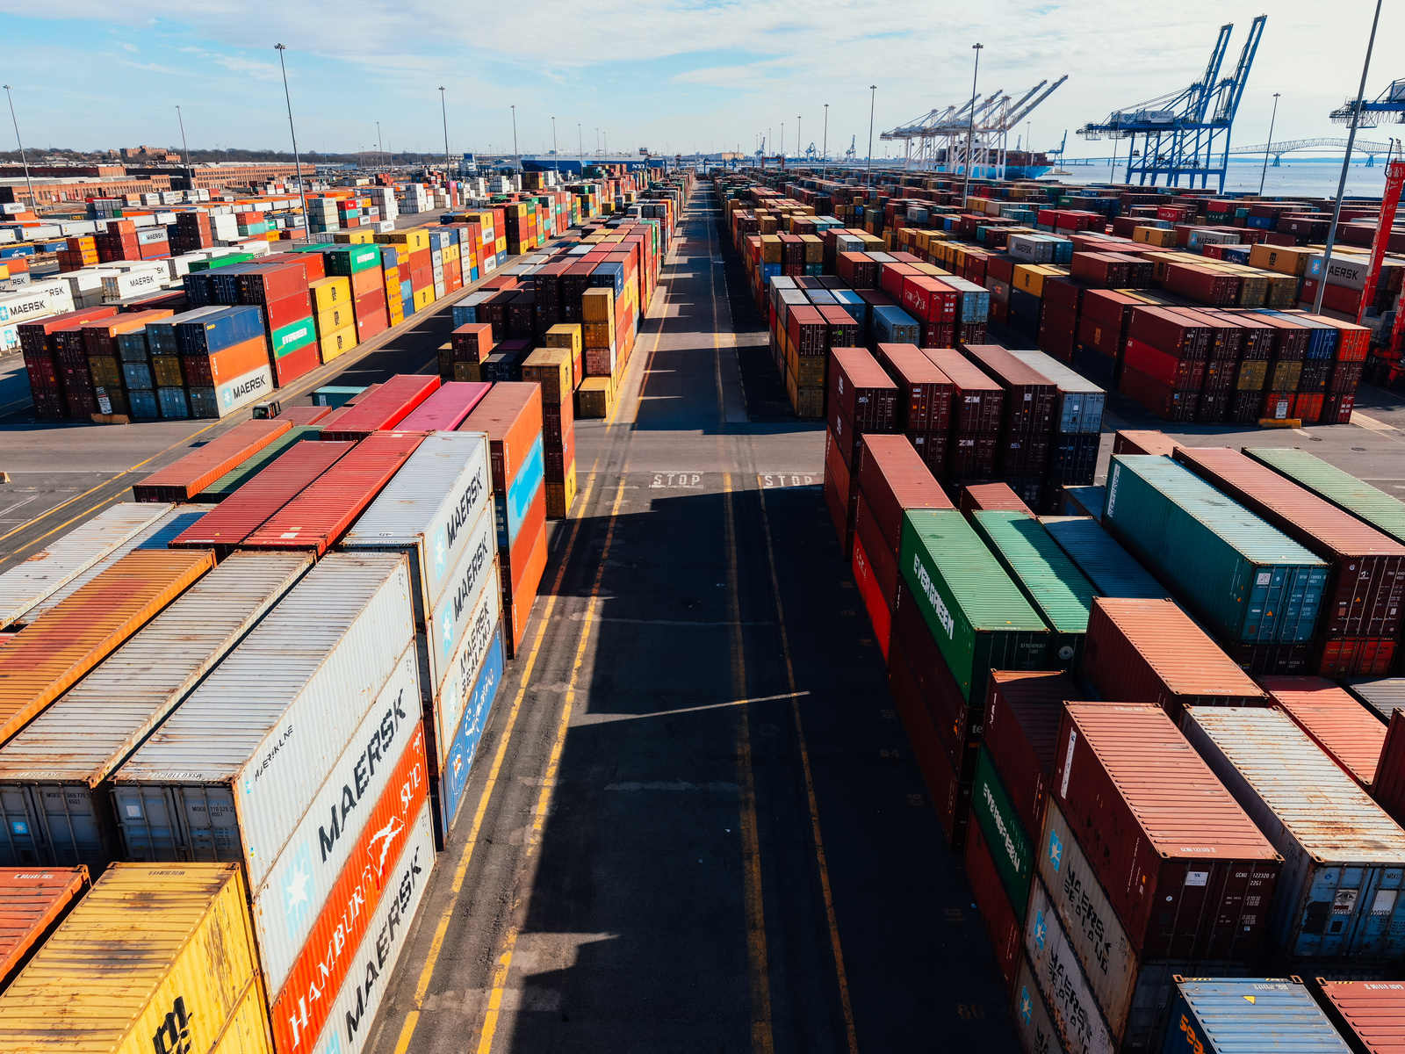
The Logistics Legends Author Program
SGN & SGA – The Logistics Influencer Academy
Calling The real-life Logistics Legends
Calling The inspirational logistics leaders and superheroes!

Slide 2
WHAT
The very first logistics superheroes leaders’ book.
Inspirational stories from authentic logistics experts and leaders.
Book Title: Logistics Legends
Volume 1
Subtitle: The Inspirational and untold stories of logistics leaders and superheroes behind the Scenes.

Slide 3
WHY
Why be PART of this:
Do you want to be the very first logistics superheroes' author representative?
Do you want to have your life stories shared with the world?
Do you want to make a difference? To do something that is not just for yourself but also for others and the world.
Do you want a higher opportunity to be well known and possibly more public opportunities, such as to be an influencer or speaker?
Do you want to leave a legacy, have a great name, and inspire and influence more people in the future?

Slide 4
WHY CHOOSE SGN AS YOUR PUBLISHER AND SGN FOUNDER TO HELP YOU WITH THE AUTHOR JOURNEY?
Do you want someone who has already written and published international
best-seller books to guide you?
Do you want someone who understands your background and industry, admires, and appreciates you and your industry, guides you and finds the best in you?
Do you want to enjoy being an author, sharing your stories, and leaving all other complicated processes to us?
Then this is for you!!!

Slide 5
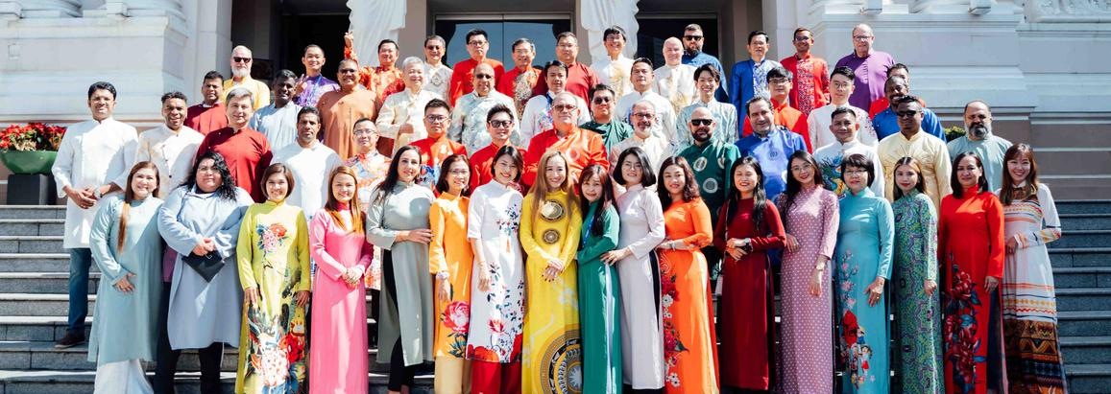
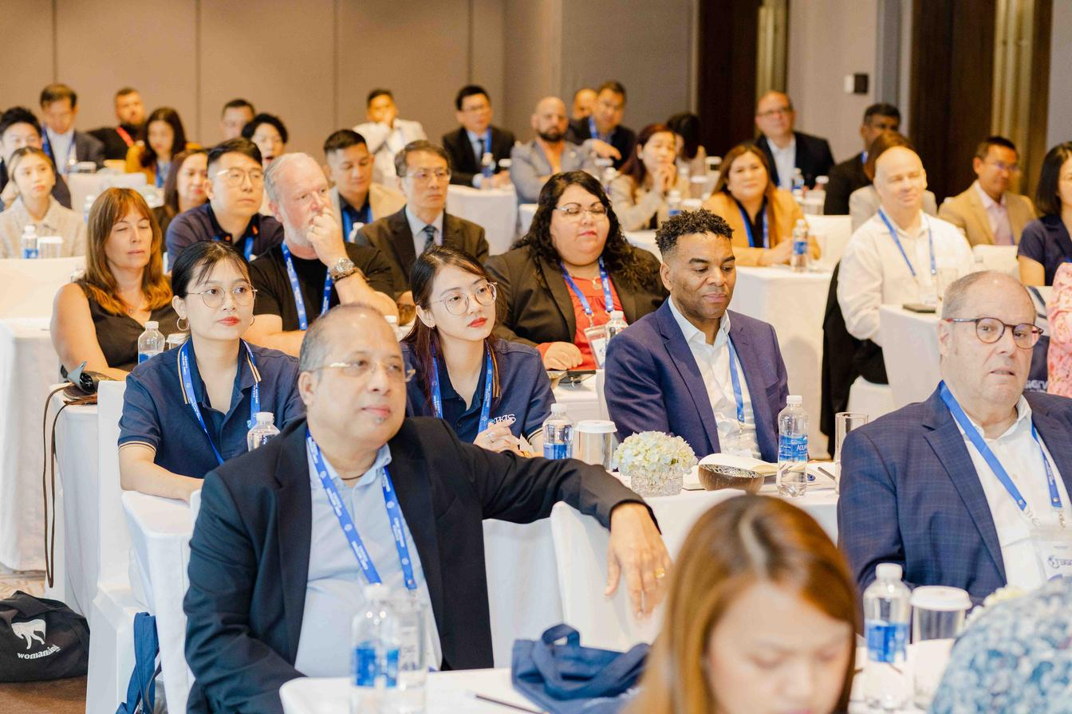
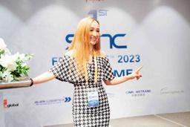
SGN Founder’s BIO: Kristy's Bio Brochure (signaturegln.com
SGN Founder’s BIO Video: https://youtu.be/4JoYHbPPDSs
SGN’s founder’s Published International Best-seller book: The Joyful Leader in You – Signature Global Network (signaturegln.com)
Intro of <<The Joyful Leader in You>>: https://youtu.be/Ttj-rF6i8wg

Slide 6
WHO AND QUALIFICATION
You have been in the logistics industry for at least ten years.
You are the business owner, or you have been in a leadership or management team.
You have a dream to be an official author, or you want to make an impact.
You want to contribute the future generations and leave a legacy.

Slide 7
HOW? WHAT DO YOU NEED TO DO?
Nothing except for writing down your stories.
Come back to show interest; you will be trained about writing with a step-by-step blueprint and online weekly free training sections.

Slide 8
WHAT TO EXPECT?
You will become an official international author.
You will likely become the international bestselling author on Amazon with other authors.
Signature Global Network PTY LTD will publish this book.
It will potentially reach out to millions of readers across all industries, but it will be one of the very first ones in the logistics industry. Unique and interesting!
It will reach out to many media internationally as the press release in the long term.

Slide 9
WHEN?
You will need to confirm back ASAP.
The program will start once we have a minimum of 20 authors—a maximum of 26.
The first estimated program coaching and starting on 25th June 2024.
The book publication is expected to be by Nov and before Christmas.
You must submit your draft of roughly 3000 words by
the latest 25th September.
-New program will be advised with new timelines.

Slide 10
HOW MUCH?
We would love to do this for free to get the fantastic stories to the world. However, we need fees to run this program, including all publications, cover designs, editing, etc.
Enquire NOW :
SGNINFO@SIGNATUREGLN.COM
or Register to see if you are qualified.

Slide 11
WHAT SERVICES ARE INCLUDED?
You will be added to AUTHOR’s Facebook Group.
You will have one free one-on-one session- 1 hour with the coach SGN President.
You will have access to Q&A on the weekly group catch-up call, if any until you have your book written.
You will receive online coaching videos to help you with the blueprint and inspiration for writing these stories.
You have unlimited access to online support during the program period -agreed as 3 months.
We help you to do your book editing.
We help you to do book publishing and all other things so that you can enjoy the writing process and get ready to be an official author.
We will help to promote the book; however, you are welcome to do your part so that this book will be sold even better.
You will receive five hard copies for free. If you want more, we will order for you at a much lower price.

Slide 12
FAQ
Do I have to be an SGN member?
NO, but SGN members will be prioritized before it's fully taken.
Join SGN to enjoy the privilege: Claim your spot at SGN here.
Does it restrict the locations? be an SGN member?
No, we welcome worldwide logistics leaders!! The more different countries, the better!!
Do I have to write the best English?
NO!!! We want your story and YOU to be heard! You and your stories are unique.
English doesn't have to be your first language!!
We will hire professional editors to ensure the final version of your work is published professionally.
If any extra edition is needed, you can enquire about it separately at a bit of extra cost, or if you are happy with what can do, no need to worry and pay extra.

Slide 13
FAQ
What if I don’t know how to write or where to start?
Don't worry. You will be fully trained and coached well to have it ready
Don't worry. We will have a professional editor to help you to edit the book's content.
What is the timeline for volume 1 of Logistics Legends?
The book script of 3000 words from you needs to be written by latest 25th September. -
The book is aiming to be published between 20th October to 20th November.
It will be a great success and a great sale release before Christmas.
*If there is any delay in the program, you will be informed your book will be rolled for the extra months, usually the slots will be filled quickly.

Slide 14
FAQ
What if it's already fully booked?
Register first and we can add you to the waiting list for the next book volume soon. You can still register, and we will provide you a link to pay a deposit to block your seats for the next volume.
If you can sponsor this volume, you will get a free copy of 10 books and the priority seats for the next volume.
What are the next steps?
You register and block your slots.
Please wait for our confirmation.
We analyzed your application.
Once your application is approved, you will receive a confirmation by email with an agreement and payment link.

Slide 15
Block your seats
Schedule a call here:
https://calendly.com/cuilanguo/30min
or Email us:
Email: sgninfo@signaturegln.com
Action Now!

Slide 16
Check out our Digital Marketing and Creative Services here.
Feel free to purchase our CEO’s book here.
Check out our member’s testimonials here.
Check out our last conference playlist here.
Claim your spot at SGN here.
Or follow us on all social media by clicking on our website here.
FEATURED BY

